Slide 1

Retail Data analysis
Presented By:- Insha Ahmed
Date:- 18/06/2024

Slide 2
Introduction
Overview of the Project
Aim:
To use sales data analytics to uncover actionable insights that drive strategic decisions and improve business performance
Objective:
Analyze customer behaviors, product preferences, and store/channel performances.
Identify key metrics and trends influencing sales patterns and seasonality.
Define customer segments and product categories for targeted marketing and sales strategies.
Provide recommendations to optimize marketing campaigns and work on customer retention strategies

Slide 3
Agenda
Data
Overview
Analysis & Insights
Recommendations

Slide 4
Data Overview
Data Sources:
FACT Table: Orders
DIMENSION Tables: Customers, Order Payments, Order Review Ratings, Products Info, Store Info
Data Cleaning and Preparation:
Handling missing values and duplicates.
Data type inconsistency in Datetime values replaced with consistent format: YYYY-MM-DD HH:MM:SS
Period of available Data: March 2nd 2020 – December 9th 2023
Some values of Total Amount in Orders Table and Payment Value in Order Payments are not matching.
Values in Quantity column is updated to handle it.

Slide 5
High-Level Metrics
Total no. of Orders: 98,666
Number of Customers: 98,575
Total Revenue: ₹ 1.81 Cr.
Total Profit: ₹ 26.6 L
Total Quantity: 1,34,936
Average Profit Per Customer: ₹ 26.98

Slide 6
Key Findings from High-level Metrics
With a total profit of ₹ 26.6 L, the profit margin is approximately 14.73%. Explore cost reduction strategies and higher-margin products to increase overall profitability.
The total discount given (₹ 5.52 L) results in an average discount per order of ₹ 5.6 and per customer of ₹ 4.97. This is relatively low compared to the average order value, indicating discounts are not a significant driver of sales. Consider targeted discount campaigns for high-value customers and during slow sales periods to boost purchase frequency

Slide 7
Key Findings from High-level Metrics
The repeat purchase rate is 10.06%, but repeat customer percentage is only 0.04%, indicating a high proportion of one-time buyers (99.96%). Develop retention strategies such as personalized marketing, loyalty rewards, and customer engagement programs to convert one-time buyers into repeat customers.
The average order value (₹ 183.024) and average sales per customer (₹ 183.19) are nearly identical, reinforcing that most customers make a single purchase. Implement cross-selling and upselling techniques to increase the basket size and value per order.

Slide 8
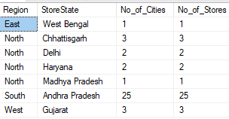
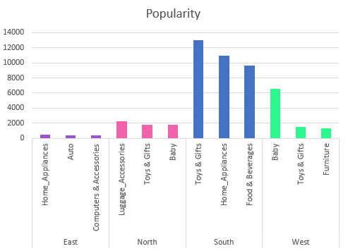
Store Analysis
Region-wise Store Distribution
37 Active stores out of 534
Indicating a significant no. of stores either closed or with missing sales data.
4 regions: East, West, North, and South.
North has stores in 4 states, while other regions have stores in 1 state each.
Single-store cities - cautious approach to market penetration
Assess performance and market potential. Consider opening additional stores in high-demand areas.
Top 3 categories vary by region - diverse customer preferences
Marketing strategies to align with regional preferences. Ensure ample stock and promote those categories heavily in that area.
Top 3 categories by Region

Slide 9
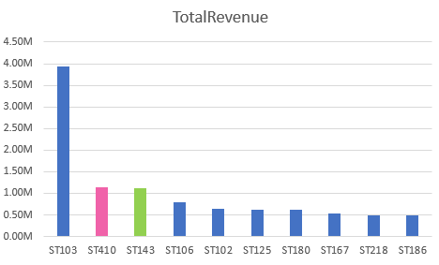
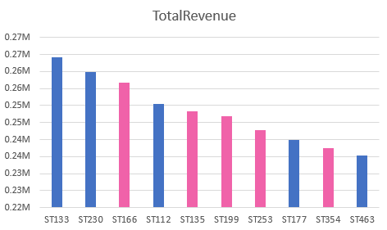
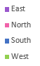
Store Analysis
Top 10 best Performing stores Bottom 10 worst Performing stores

Slide 10
Store Distribution and Performance Insights
Many high-performing stores in South region, Andhra Pradesh - strong market engagement and operational efficiency
Replicate the successful strategies from Andhra Pradesh stores in other regions.
Staff training, inventory management, and customer engagement practices.
Stores in the North region, particularly in states like Delhi and Haryana, are not performing as well.
Investigate reasons behind the poor performance. Analyze local market conditions, competition, and customer preferences.
Implement targeted improvement plans - localized marketing campaigns, and better inventory management.

Slide 11
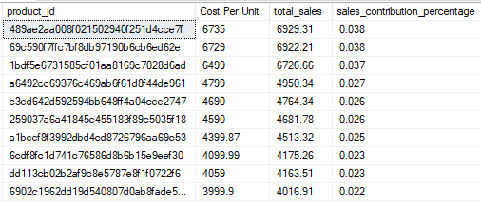
Product Analysis
There are a total of 32,951 different products spread across 14 categories.
Top 10 expensive products

Slide 12
Product Analysis
The top 10 most expensive products were each bought only once.
Possible reasons - high price points, limited awareness, or lack of repeat purchase incentives.
Implement marketing strategies to highlight these products' unique premium features, benefits, and exclusivity and offer loyalty incentives or discounts to encourage repeat purchases.
Customers who bought these expensive products might belong to a high-value customer segment. Identify and segment these customers for targeted marketing campaigns.

Slide 13
Customer Analysis
Customer Preferences
Preferred Product Category: Toys & Gifts
Preferred payment method: credit card
Preferred store: ST103 (25.7895%)
Preferred channel: Instore
Customers who purchased in all the channels: 1

Slide 14
Customer Analysis
Focus marketing efforts and inventory management on the "Toys & Gifts" category. Capitalize on its popularity and expand product lines within this category
Analyze factors contributing to the popularity of ST103, such as location, customer service, product range, and promotional activities. Apply successful practices from ST103 to other stores to improve their performance.
Enhance the in-store shopping experience with personalized customer service, engaging displays, and interactive elements
Online orders are low, most likely due to lack of awareness, or past issue with delay, damage in transit, etc. Promote the other channels by expressing the convenience they can offer.

Slide 15
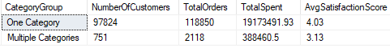
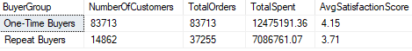
Customer Analysis
Behavior of customers who purchased one category and purchased multiple categories:
Behavior of one-time buyers and repeat buyers:

Slide 16
Customer Analysis
Customers who purchase multiple categories have higher total spent per order but lower average satisfaction scores compared to those who purchase a single category. Address potential issues such as product quality, customer service, etc.
One-time buyers constitute the majority of customers but have lower total spending compared to repeat buyers. Repeat buyers have a significantly higher total spend. Implement retention strategies to convert one-time buyers into repeat buyers.

Slide 17
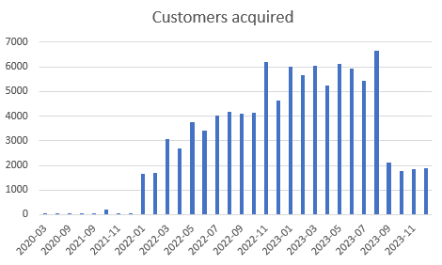
Customer Acquisition
Average no. of customers acquired per month: 3080
Maximum no. of customers acquired in August 2023

Slide 18
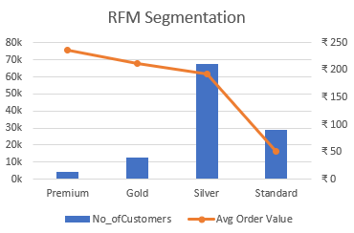
RFM Customer Segmentation
Premium: High satisfaction (4.18)
Offer VIP memberships with benefits like early access to sales, exclusive product previews, and personalized shopping experiences. Use personalized email campaigns highlighting luxury products
Gold: High satisfaction (4.07)
Offer gold-tier memberships with benefits like free shipping, and exclusive discounts.
Silver: Moderate satisfaction (3.47)
Enhance customer experience by Improving product quality and customer service to boost satisfaction.
Standard: Moderate satisfaction (3.57)
Introduce a points-based reward system for frequent purchases, offering discounts or free items after a certain number of purchases. Increase advertising efforts focusing on deals, discounts, and bundled offers.

Slide 19
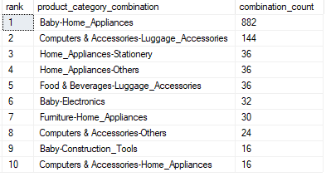
Category Analysis
Most profitable category: Toys & Gifts
Contribution: 15.07%
Most popular category during first purchase of customer: Toys & Gifts ( Frequency: 14,955 )
Top 10 maximum & minimum rated products from Auto
Metrics indicate that the main target audience should be families with kids. Marketing strategies to appeal to families, emphasizing products and bundles that meet their needs. Highlight family-friendly promotions during key seasons and events, Back-to-School offers, and Vacation sales.
Develop targeted cross-selling strategies that promote these combinations. Offer bundled discounts and promotions to encourage purchase across these complementary categories.
Cross-Selling Products

Slide 20
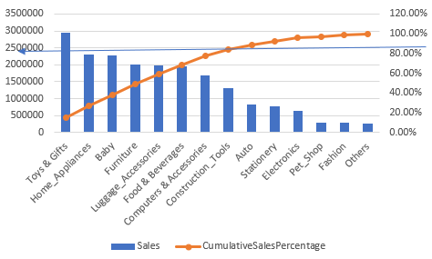
Category Pareto Analysis
The top 5 categories out of 14, account for approximately 65% of total sales. The top 8 categories contribute to over 80% of total sales.
Allocate resources effectively to maximize sales and profitability in these key areas.
Categories like Electronics, Pet Shop, and Fashion contribute the least to total sales.
Strategic actions such as repositioning of store layout, targeted marketing, or even phasing out low-contributing products to optimize the product portfolio.

Slide 21
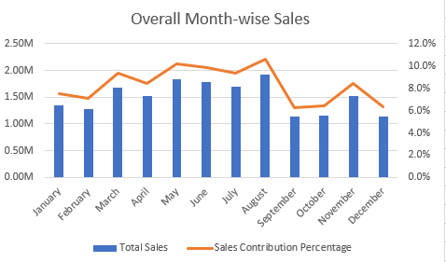
Sales Trends and Seasonality
Overall Highest Sales Months: August
Sales Amount: ₹1.9M Contribution Percentage: 10.65%
Overall Lowest Sales Months: Sept
Sales Amount: ₹1.1M Contribution Percentage: 6.30%
Implement seasonal promotions and marketing campaigns in September to boost sales during this low period, and ensure inventory is well-stocked for the August peak.

Slide 22
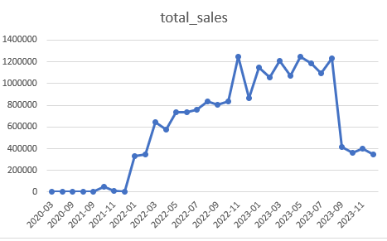
Sales Trends and Seasonality
Steady growth in Sales over 2022
Although the sales growth is seen in 2023, sales peaking in mid-2023, there is a dip in sales every other month and
Towards the end of the year there is a sharp decline in sales.

Slide 23
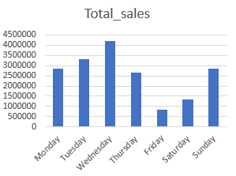
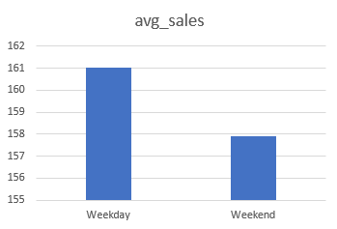
Sales Trends and Seasonality
Sales by days of the week
Sales peaked in mid-week, specifically on Wednesdays, while sales were lowest towards the weekends, specifically on Friday.
Low sales on weekends could indicate that customers are busy engaged in other recreational activities, on holidays, etc.
Introduce mid-week promotions to capitalize on high traffic and explore strategies to boost sales on Fridays, such as surprise Flash sales like ‘Fantastic Fridays’, etc
Weekdays vs Weekends

Slide 24
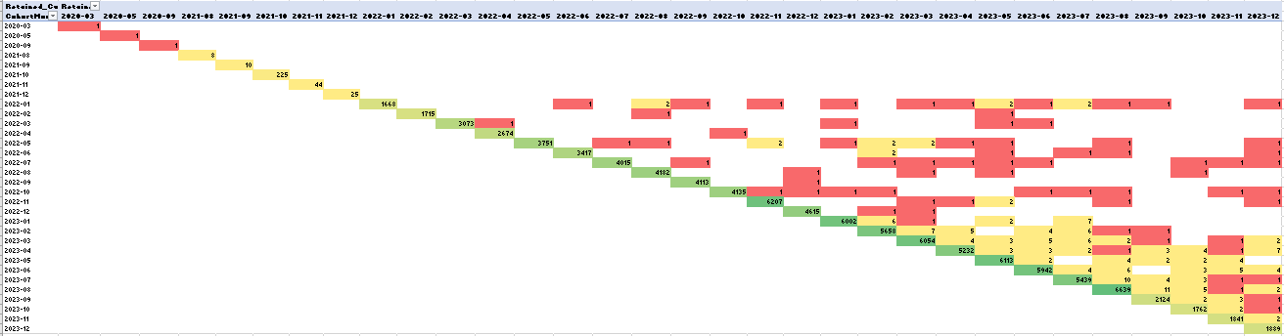
Cohort Analysis – Customer retention
Significant drop in customer retention consistently across all cohorts.
Customer feedback
Improve Customer service
Improve product quality
Offer incentives like Loyalty programs and discounts

Slide 25
Overall Recommendations
Loyalty Programs: Implement and promote loyalty programs to encourage repeat purchases and increase customer retention.
Cross-Selling and Upselling: Use personalized recommendations to cross-sell and upsell products, increasing average order values.
Targeted Discounts: Offer targeted discounts and promotions to high-value customers and during off-peak periods.
Customer Engagement: Enhance customer engagement through personalized marketing and communication strategies.
Cost Management: Continuously evaluate and optimize cost structures to improve profit margins.
Product Bundling: Encourage customers to purchase across multiple categories through bundled deals and cross-category promotions.

Slide 26
THANK YOU

